Slide 1

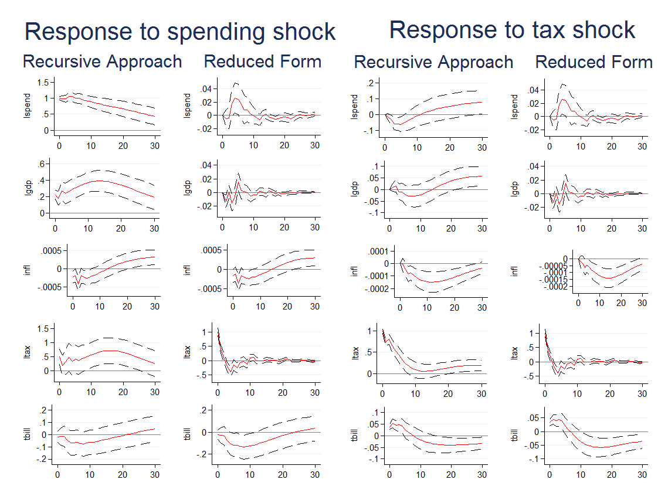
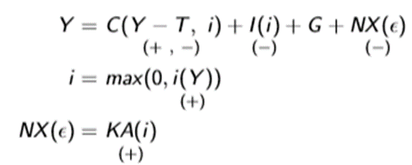
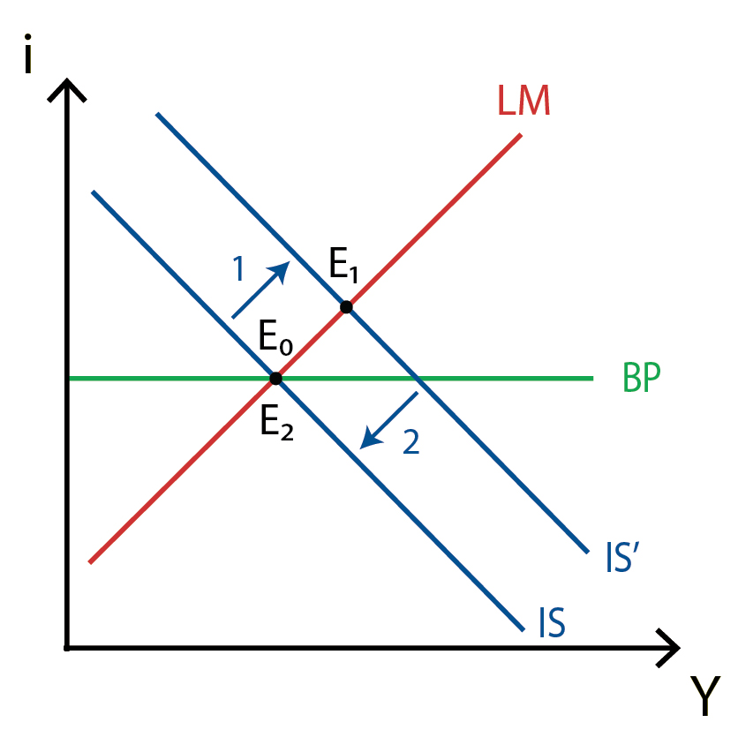
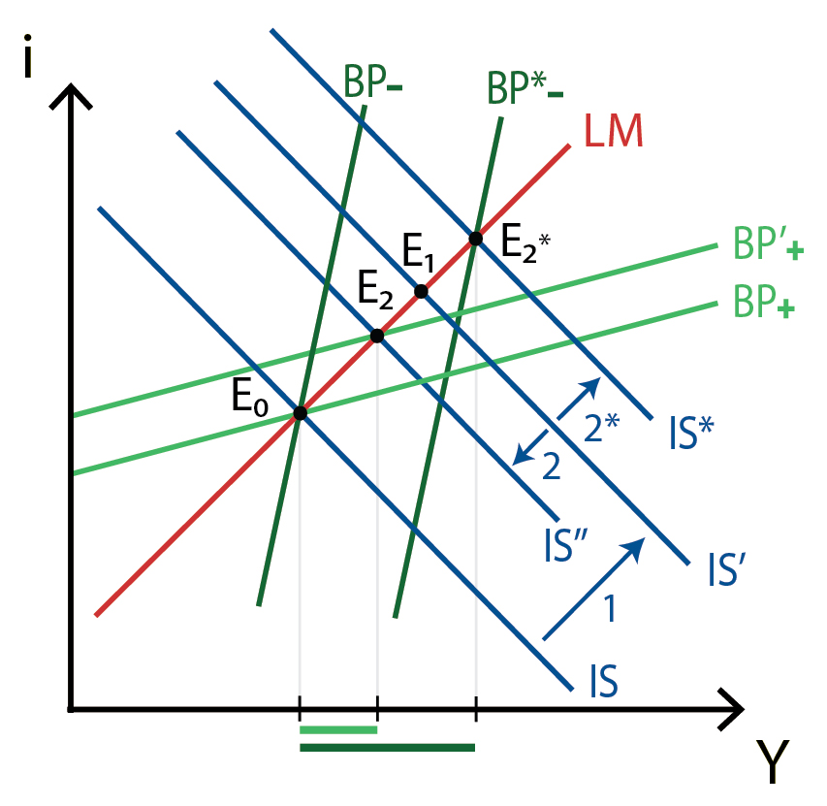
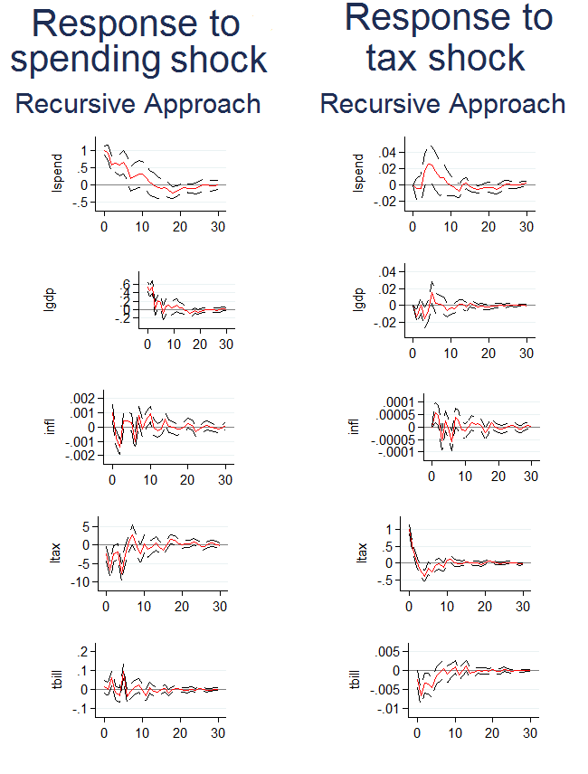
Tightening the Belt: The Impact of Fiscal Policy
Doga Akar Bilgin ‘16 – (Sponsor: Professor David Cuberes)
Introduction
Since the financial crisis in 2007, developed economies across the world find themselves in a precarious position unseen since the Great Depression. Output remains depressed below potential and central banks are impotent against low rates of inflation. The Federal Reserve has failed to achieve its 2\% inflation target for 35 consecutive months, while European countries remain mired in seemingly perpetual stagnation, and inflation in England is still below target. The seeming failure of monetary policy to ensure full employment through effective aggregate demand management is due to the zero lower bound (ZLB) and the liquidity trap. Since the central bank cannot lower their interest rates further, it cannot increase aggregate demand to close the output gap. Therefore, aggregate demand shocks can persist.
Owing to the failure of conventional monetary policy in insuring full employment, it is imperative to investigate alternative policies towards macroeconomic aggregate demand management at the ZLB. One possibility is to examine the impact of fiscal policy on GDP. Many countries have cut government spending and raised taxes to boost confidence and improve the economy. Other economists have argued that lowering spending has deepened recession.
I examine the impact of fiscal policy on GDP. I find that, in the US, fiscal policy is expansionary. Notably, I find that government spending has stronger impacts on GDP than changes in taxation, especially when monetary policy is constrained by the ZLB.
Theory
To motivate my paper, I will employ the IS-MP-BoP. The model is a 3-market, 1-period model defined by the following equations, and illustrated on the graphs:
This model predicts that under flexible exchange rates, and perfect capital mobility, fiscal policy has no impact on the economy. On the other hand, introducing some frictions in capital markets results in some impact of fiscal policy on GDP.
Method and Data
I use a structural vector autoregression (SVAR) and VAR approach. A VAR is an atheoretical model where each variable is regressed on lags of itself and of the other variables. The structural VAR is that the former allows for contemporaneous effects between variables. However, it requires that we specify some identifying restrictions on how variables interact with each other contemporaneously.
I examine two alternate sets of identifying restrictions. The first is from Perotti (2005) which uses a set of econometric techniques and institutional knowledge to develop identifying restrictions to estimate the model. The second approach is a recursive method. This method relies on identifying the order in which variables are determined. In this model, I assume that variables are ordered as follows: government spending, GDP, inflation, taxation and interest rates. I describe my data in the table below.
I also examine two different subsections in my data. I first look at 1955:1 to 2007:4, to establish a baseline. While there is heterogeneity in economic conditions in this period, it allows for a baseline to which I can compare the post-recession period from 2008:1 to 2015:4.
Zero Lower Bound
Looking at the post-recession sample, I attempt to see if a difference in the effects of fiscal policy arises in this subsample. The theoretical literature suggests that fiscal policy, especially when monetary policy is constrained by the zero lower bound, is especially effective.
Looking at the IRFs, we see large changes in taxation, however, this has little impact on key economic variables. It is possible that the Perotti (2005) coefficients are different in this subsample; the tax base, for example may be more responsive to changes in growth, and less responsive to changes in inflation, for example. Tellingly, we see that the recursive approach and Blanchard and Perotti yield different estimates from the previous time period. This is likely due to a change in the fundamentals of the economy, and these approaches are less effective at identifying true shocks. Indeed, this occurs over the regular sample as well. Previous papers note that their estimates for elasticity of taxes to growth vary across the period they consider.
It is also possible that the nature of the crisis impacts the relative ineffectiveness of taxes. As a balance sheet recession where agents were simultaneously deleveraging, disposable income may have gone towards repaying debt as opposed to consumption (i.e. the marginal propensity to consume was low). In comparison to taxes, government consumption enters the consumption function directly, thereby resulting in a greater impact on output.
On the spending side, we continue to see a strong impact on growth. As expected, the initial response of GDP to the change in spending is greater at the ZLB. The relatively short response of GDP to increases in spending is due to the fact that increases in spending will dissipate to the mean more quickly. This is also consistent with the declining ratio of government spending to GDP following the recession, as state and local governments cut spending. It is therefore possible to conclude that declines in spending have reduced the speed of the economic recovery, while the taxation-based aspects of stimulus have largely been ineffective.
Indeed, a similar dynamic likely drives the results for tax shocks at the ZLB. We see that tax revenues have a brief negative impact on consumption, and a negative, albeit insignificant impact on output. This is likely a product of the specification. Indeed, reduced form estimations support this interpretation. While these estimates also agree that taxation has less of an impact than spending, they predict larger impacts than the recursive approach.
Results
Across the models, a shock to spending results in significant increases of GDP. This indicates that government spending is expansionary in our sample, and therefore qualitatively consistent with the IS-LM model, which predicts a positive relationship between government spending and GDP. The recursive approach and Blanchard-Perotti approach both offer similar predictions, predicting a rise of 0.2% of GDP in response to a 1% spending shock. Considering that the public sector comprises approximately a third of GDP, this implies that a $1 spending shock results in a 60 cent contemporaneous rise in GDP.
Nevertheless, the results are still qualitatively consistent with a multiplier effect. GDP increases over time, which is consistent with an interpretation involving multiple multiplier rounds after the initial shock. Moreover, as would be expected by an AD-AS model, interest rates rise in response to greater government consumption over time. This is consistent with the view that inflation rises as output rises.
In comparison to spending, changes in taxes have less drastic and less persistent effects on the economy. In the recursive approach and Blanchard and Perotti models, rising taxes lower then raise output in the economy. However, these estimates are insignificant. In the reduced form, taxation does not seem to impact GDP significantly or predictably. (This divergence between the models did not arise in estimates of spending.) This is likely because the contemporaneous impact between GDP and taxation is greater than with spending. Therefore, the reduced form estimates will exhibit greater cross-correlation, and provide biased results.
Nevertheless, the reduced form corresponds with the other models for the predicted path of inflation, taxation and interest rates. Looking at tax increases, we see that they persist less than spending increases and impact the economy less overall. The relative unresponsiveness of the economy to taxation compared to spending can be partially explained by the IS-LM model. In the model, we expect the taxation channel to be less effective than the spending channel. This is because an increase (decrease) in taxes enters the model through a decrease (increase) in disposable income. However, only a fraction of income is consumed. Therefore, only a fraction (the marginal propensity to consume) of the additional disposable income is consumed. On the other hand, Government spending enters into the model on a one for one basis: each dollar enters the output function
IS-LM-BoP: Equations
IS-LM-BoP: Perfect capital mobility
IS-LM-BoP: Imperfect capital mobility
Variable | Description
GDP | Gross Domestic Product
Spending | General Government Consumption and Investment
Taxes | Government revenues net of taxes and interest payments
Inflation | Log difference of Chain-Type Price Index
Interest rate | 3 year Treasury yield in secondary market

